Slide 1
A geometric distance measurement to the Galactic Center black hole with 0.3% uncertainty.
recommended by Huawei Zhang
Zhiwei Pan
2019.11.11

Slide 2
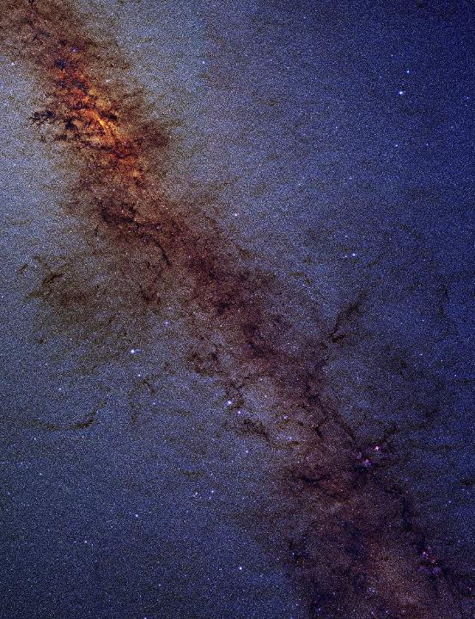
the Galactic Center
A question:
How far ???
10 kpc ?
8 kpc ?
?
( 2MASS/G. Kopan, R. Hurt - Atlas Image )

Slide 3
Outline
Background & Introduction
Instruments & Data
Results & Discussion

Slide 4
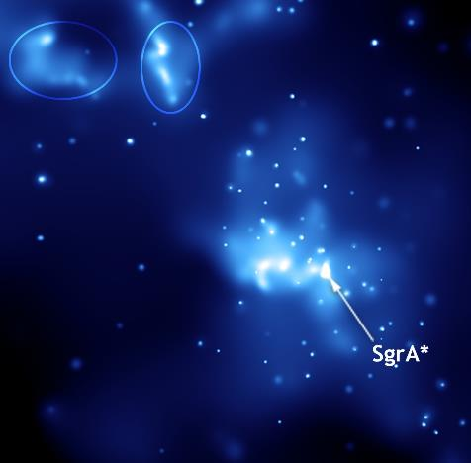
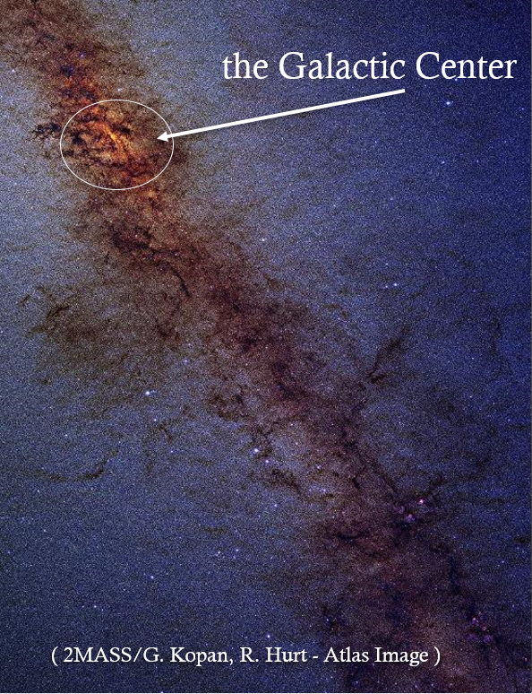
1: Background & Introduction
Sagittarius A*( Sgr A*)
a bright and very compact
astronomical radio source
at the center of the Milky Way
(NASA/CXC/Caltech/M.Muno et al.)

Slide 5
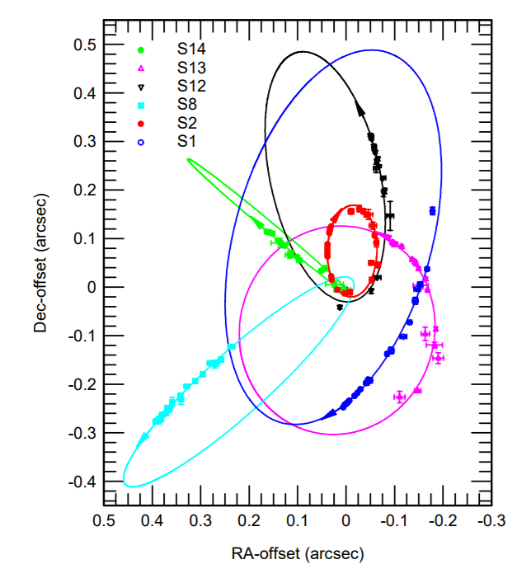

SMBH
Sun
the distance of the Sun
from the Galactic Center
$$R_{0}$$
( SINFONI)
(Eisenhauer et al. 2005)

Slide 6
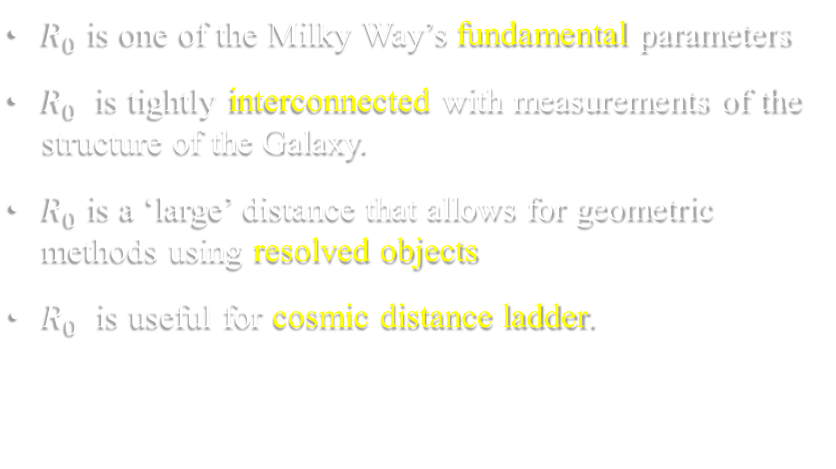

Why do we care about $R_{0}$?
$R_{0}$ is one of the Milky Way’s fundamental parameters
$R_{0}$ is tightly interconnected with measurements of the structure of the Galaxy.
$R_{0}$ is a ‘large’ distance that allows for geometric methods using resolved objects
$R_{0}$ is useful for cosmic distance ladder.

Slide 7

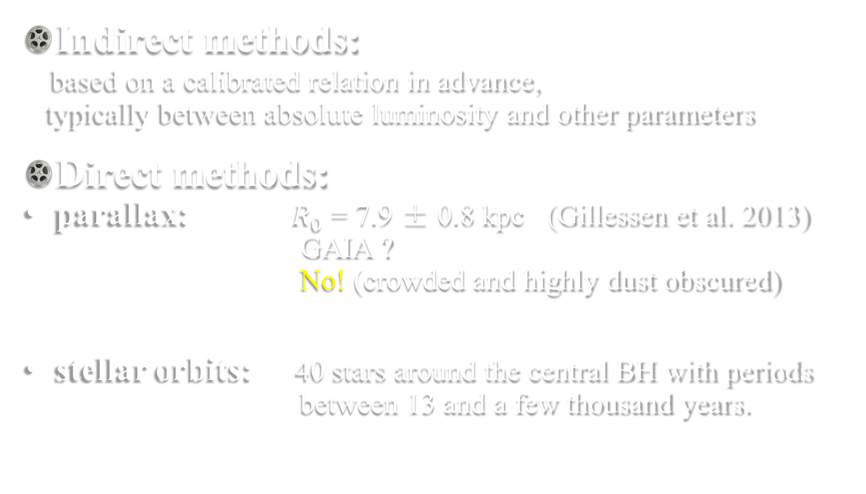
How can we measure $R_{0}$?
Indirect methods:
based on a calibrated relation in advance,
typically between absolute luminosity and other parameters
Direct methods:
parallax: $R_{0}$ = 7.9 ± 0.8 kpc (Gillessen et al. 2013)
GAIA ?
No! (crowded and highly dust obscured)
stellar orbits: 40 stars around the central BH with periods
between 13 and a few thousand years.
Yes!

Slide 8

Stellar orbit method
(km/s)
radial velocity
orbit
tangent velocity
proper
motion
(mas/yr)
S2 !
$$R_{0}$$

Slide 9
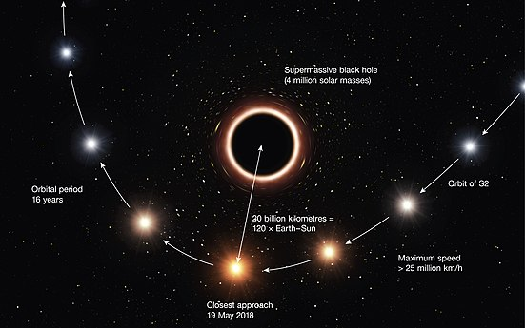
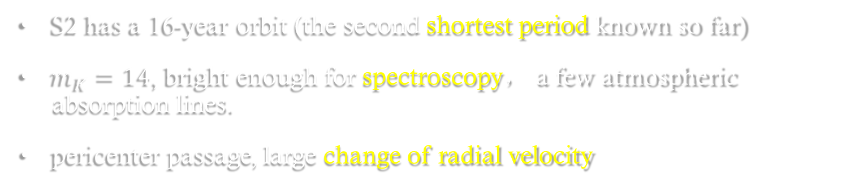

Why S2?
S2 has a 16-year orbit (the second shortest period known so far)
$m_{K}=14$, bright enough for spectroscopy， a few atmospheric absorption lines.
pericenter passage, large change of radial velocity
Previous result:
$R_{0}$ =8.32± 0.21 kpc (Gillessen et al. 2017)
better instruments !
(ESO/M. Kornmesser)

Slide 10
Outline
Little review: GC->R0->stellar orbit->S2
Instruments & Data
Results & Discussion

Slide 11
2: Instruments & Data
three instruments in VLT
The Very Large Telescope array (VLT) is the world's most advanced visible-light astronomical observatory, consisting of four Unit Telescopes with main mirrors of 8.2m diameter and four movable 1.8m diameter Auxiliary Telescopes.

Slide 12
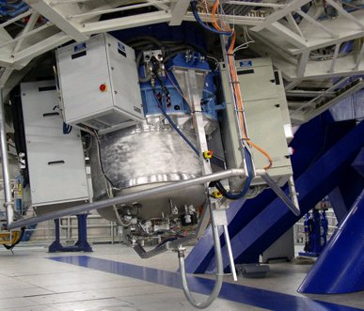
SINFONI
( Spectrograph for INtegral Field Observations in the Near Infrared )
spectrum
Radial velocity

Slide 13
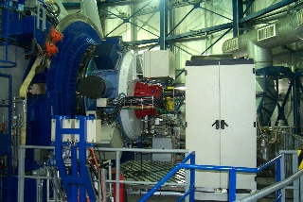
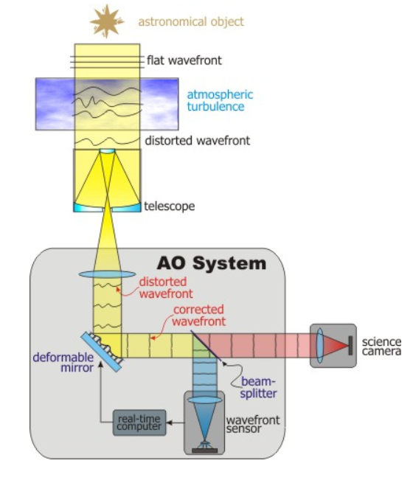
NaCo
NAOS-CONICA. It provides adaptive optics assisted images
astrometry
proper motion

Slide 14
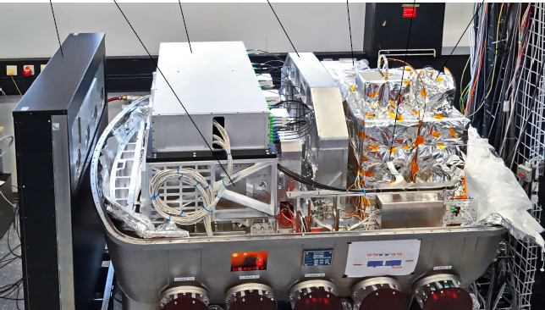

GRAVITY
GRAVITY is a new instrument to coherently combine 4 light of the European Southern Observatory Very Large Telescope Interferometer
to form a telescope with an equivalent 130m diameter angular resolution and a collecting area of 200 $m^{2}.$
It’s An interferometric instrument operating in the K band, between 2.0 and 2.4 μm. and it is designed to perform both interferometric imaging and astrometry.
proper motion

Slide 15
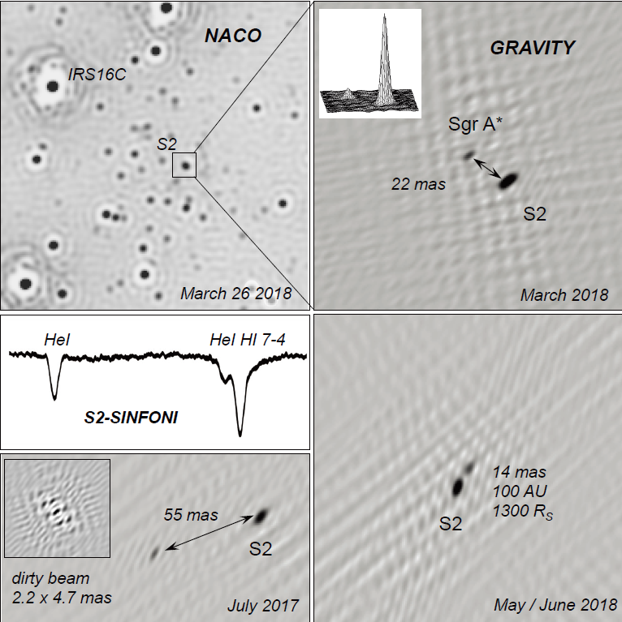
GRAVITY collaboration et al. 2017, 2018a, 2018b and 2019
2018a

Slide 16
Data since 1992
91 radial velocities from SINFONI between 2000 and 2019
169 adaptive optics based astrometry points （hereafter AO）
mainly from NaCo between 1992 and 2019
41 GRAVITY-based astrometry points in 2017 and 2018

Slide 17
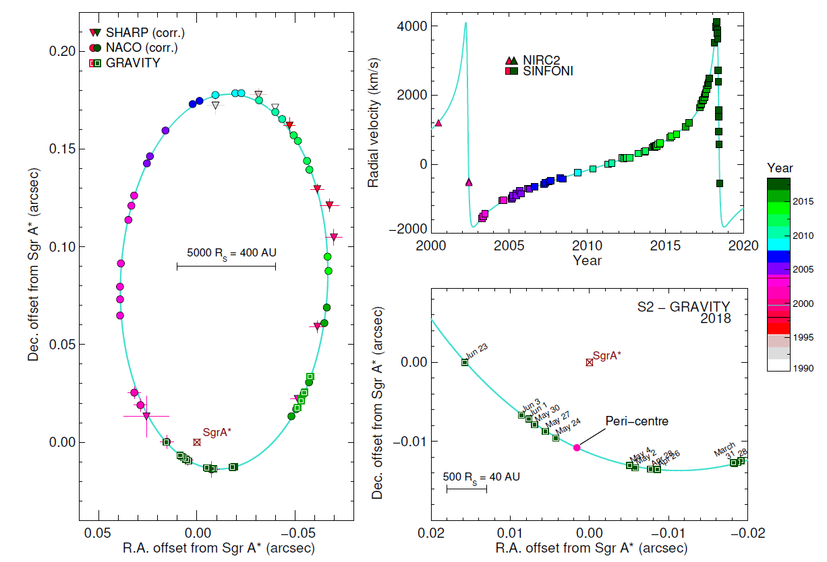
GRAVITY collaboration et al. 2018a

Slide 18
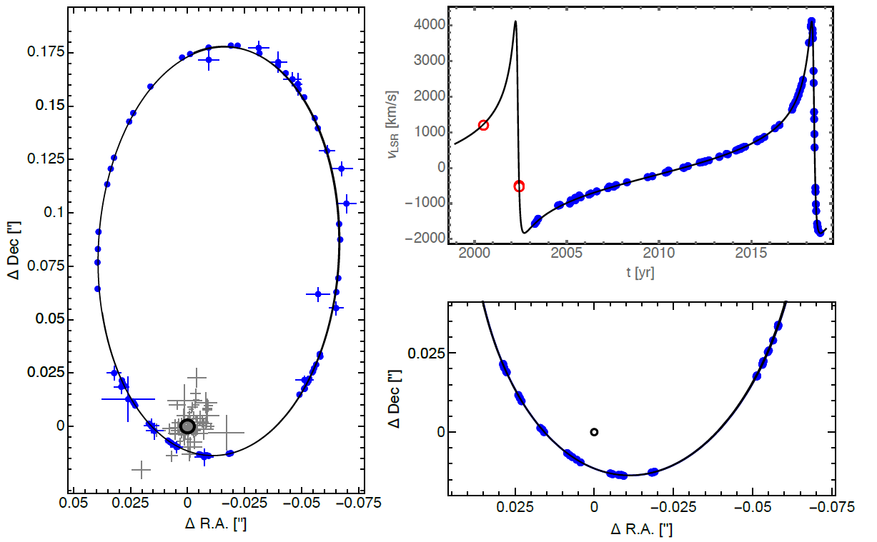
GRAVITY collaboration et al. 2019： adds ten epochs from June 2018 to September 2018

Slide 19
Three dataset
down-sampled dataset:
The distance between raw AO data points is typically smaller than the size of point spread function, which means that unrecognized faint stars might affect several data points.
noise model dataset:
such a model has the advantage that it can estimate the error avoiding any prior choices on how to treat the data.
GRAVITY only dataset（with SINFONI）

Slide 20
Outline
Little review:
S2->three instruments observation
->radial velocity, astrometry, proper motion
->generate three dataset
Results & Discussion
orbit model fit

Slide 21
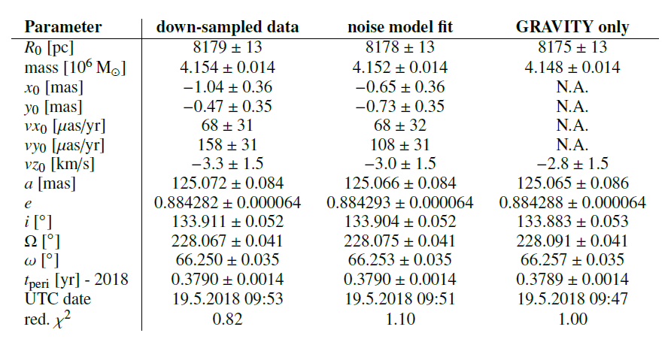
Best-fit parameters
3: Results & Discussion
Surprisingly!

Slide 22
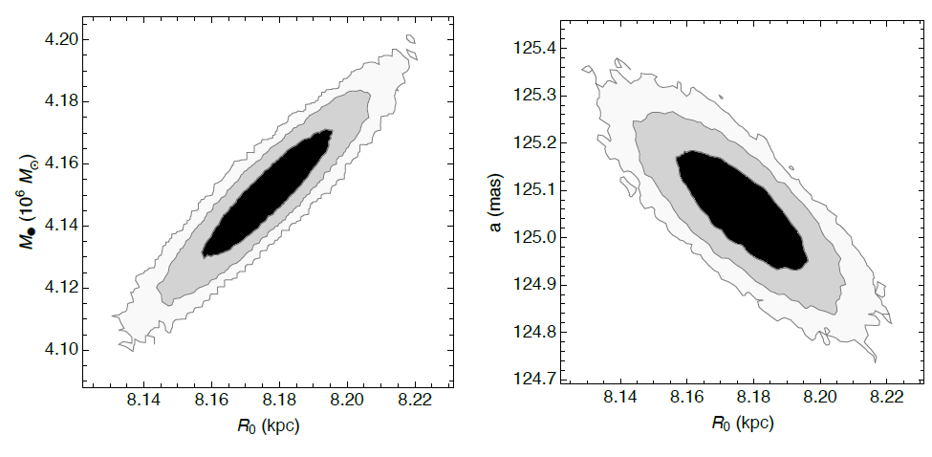
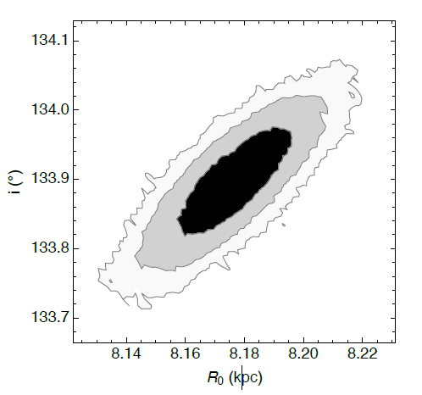

real scale of orbit
$R_{0}×a=1023AU$
(inversely proportional)

Slide 23
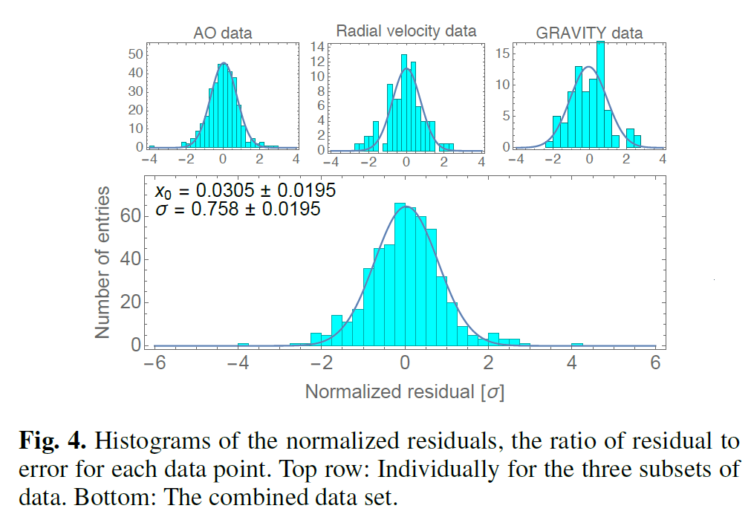
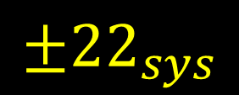
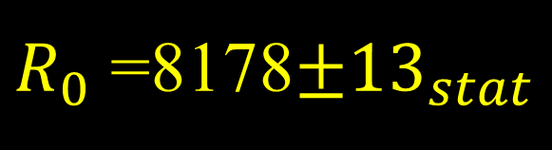
do
$R_{0}$ =8178$±{13}_{stat}$
$$±{22}_{sys}$$

Slide 24



$R_{0}$ =8178$±{13}_{stat}$
$$±{22}_{sys}$$
measurement uncertainties of the radial velocities
GRAVITY astrometry：19 pc
assumption that Sgr A* is rest: 6pc
spectrum calibration: 9pc
then: $\sqrt{{19}^{2}+6^{2}+9^{2}}≈22$
10 kpc ?
8 kpc ?
8200 pc !
How far ???

Slide 25
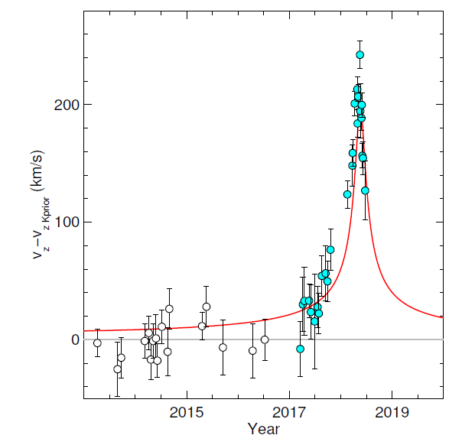
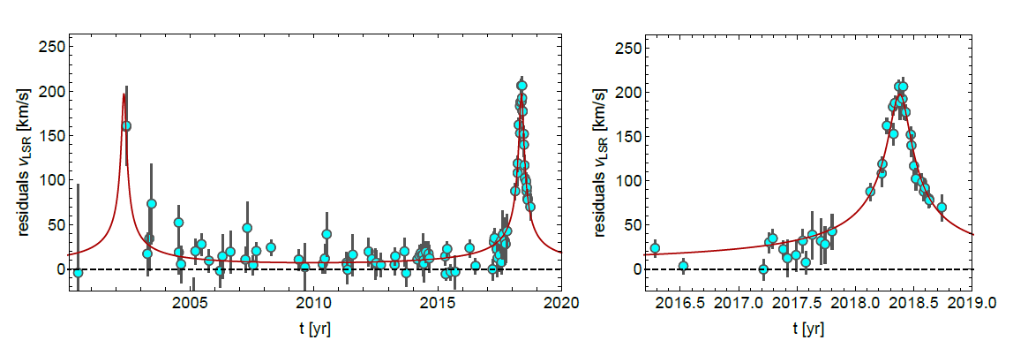
Additional result
1:confirm GR

Slide 26
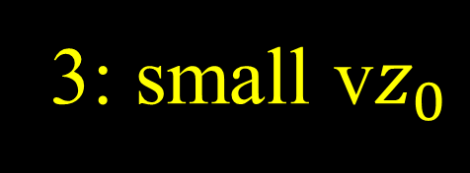
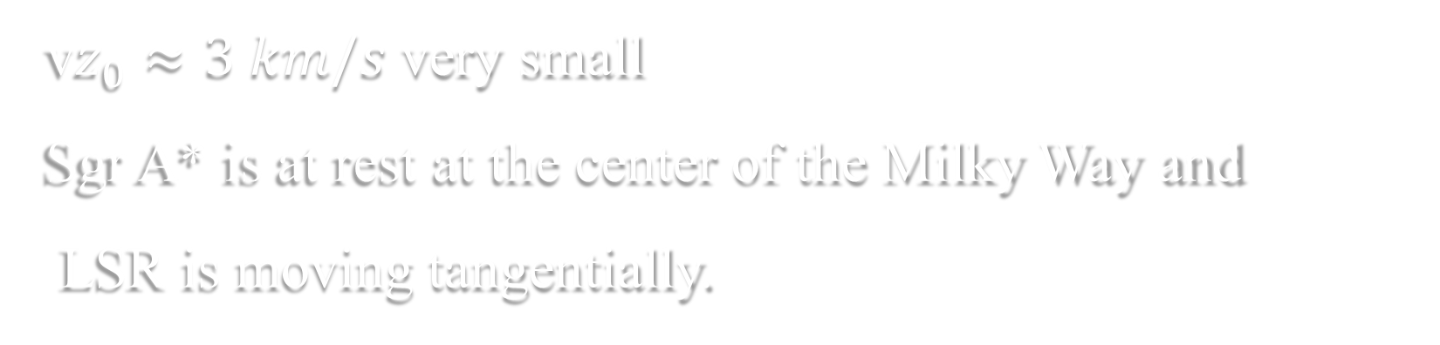

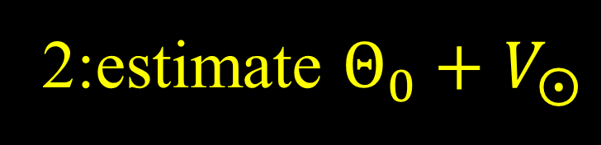
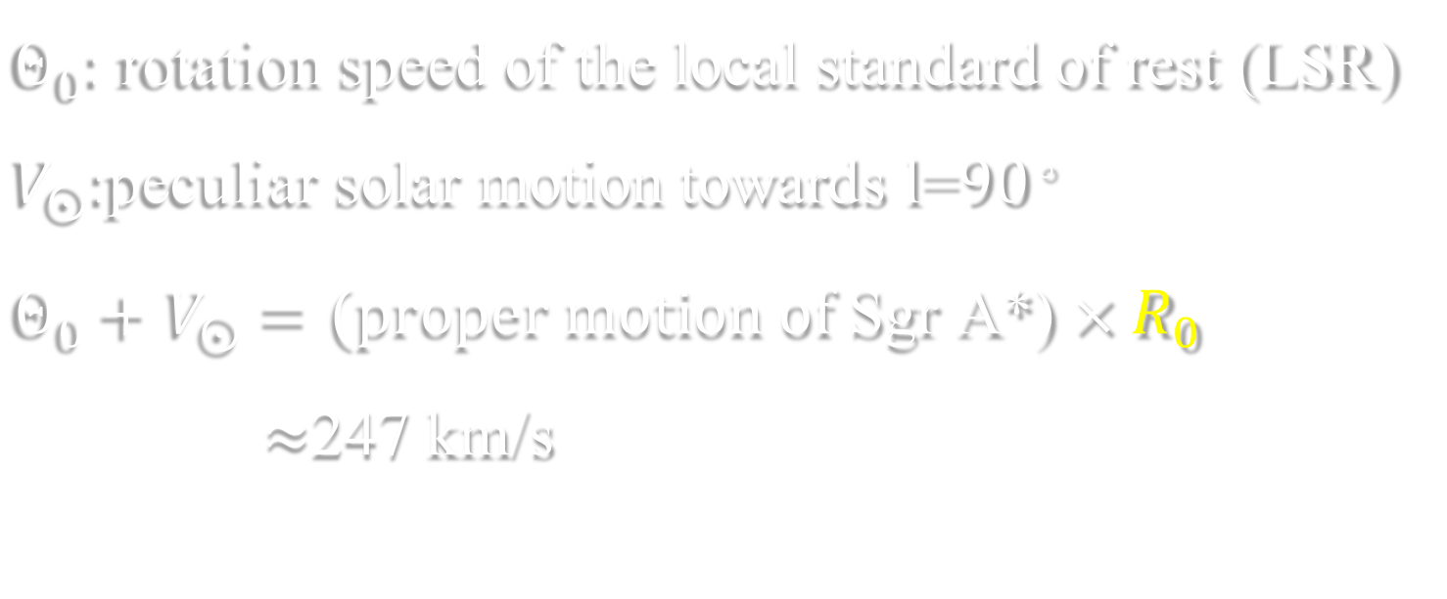
2:estimate $Θ_{0}+$ $V_{⨀}$
$Θ_{0}:$ rotation speed of the local standard of rest (LSR)
$V_{⨀}:$peculiar solar motion towards l=${90}^{。}$
$Θ_{0}+$ $V_{⨀}=(proper motion of \text{Sgr} \text{A}\text{∗)}×R_{0}$
$≈$247 km/s
3: small v$z_{0}$
v$z_{0}≈3 km/s$ very small
Sgr A* is at rest at the center of the Milky Way and
LSR is moving tangentially.

Slide 27
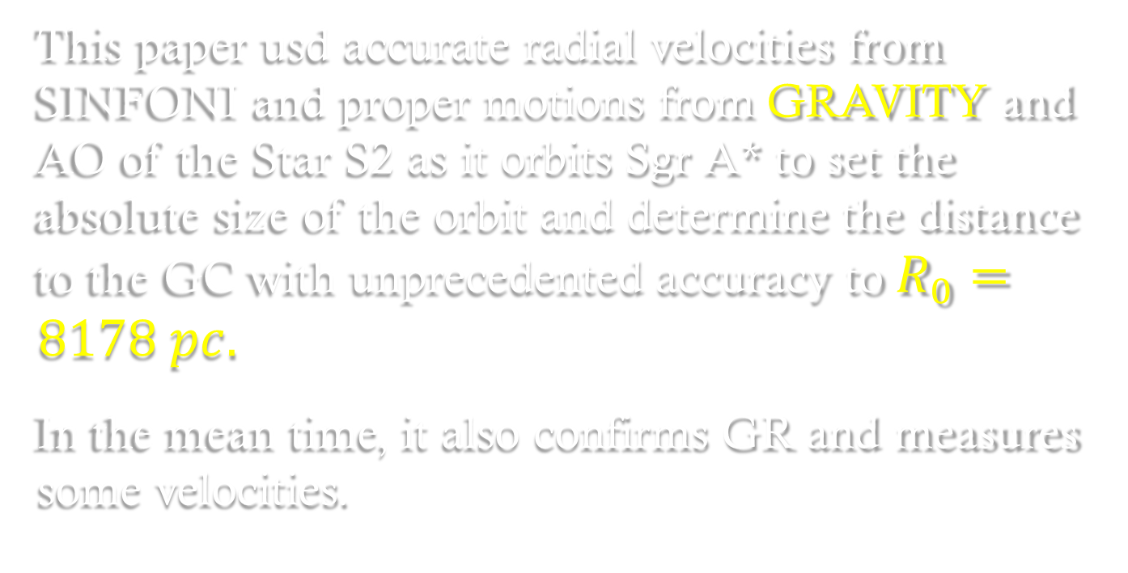
Summary
This paper usd accurate radial velocities from SINFONI and proper motions from GRAVITY and AO of the Star S2 as it orbits Sgr A* to set the absolute size of the orbit and determine the distance to the GC with unprecedented accuracy to $R_{0}=8178 pc.$
In the mean time, it also confirms GR and measures some velocities.

Slide 28
Reference
Eisenhauer, F., Genzel, R., Alexander, T., et al. 2005, apj, 628, 246
Gillessen, S., Eisenhauer, F., Fritz, T. K., et al. 2013, in IAU Symp.
289, Advancing the Physics of Cosmic Distances, ed. R. de Grijs
(Cambridge: Cambridge Univ. Press), 29
Gillessen, S., Plewa, P. M., Eisenhauer, F., et al. 2017, ApJ, 837, 30
Gravity Collaboration, Abuter, R., Accardo, M., et al. 2017, A&A, 602, A94
Gravity Collaboration, Abuter, R., Amorim, A., et al. 2018a, A&A, 615, L15
en.wikipedia.org
ESO.org

